Slide 1
Safeguarding at Uplands Junior School
How does this school keep me safe?
How do I keep myself safe?
Who is responsible for safeguarding at Uplands?

Slide 2
The safeguarding team at Uplands
Mrs Gatherum – Designated Safeguarding Lead
Mrs Southwell – Deputy Safeguarding Lead
Mrs Raybould – Deputy Safeguarding Lead
Mrs Carlisle – Head Teacher

Slide 3
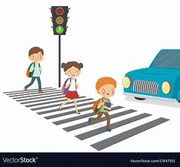
What is Safeguarding?
Keeping yourself and others safe
Recognising dangers such as cyber bullying, online safety, social media.
Being safe at home
Being safe when you cross the road.
In fact… all the time

Slide 4
Feeling and Being Safe
When children feel safe, they feel:
Happy
Content
Positive
Proud
Loved
Know they have someone to talk to if they feel worried or upset.

Slide 5
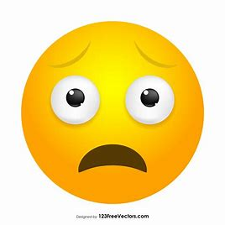
Feeling and Being Safe
When children feel unsafe, they feel..
Funny feelings in their tummy
Butterflies
Different
Sad
Worried
Being watched
Scared
Frightened
They might make bad choices or behave in a way that they don’t understand.

Slide 6
What might You feel unsafe?
Something that someone did or said to you that you do not understand.
Violence or threats
Seeing or hearing something that may worry you – online, at home, in the street.
Not being looked after properly including being hungry, not being clean or clothed appropriately.
Always being told horrible things by people you should be able to trust.

Slide 7
What you can do about things that worry you?
Tell a trusted adult – think about the many, many people you can tell.
Tell a friend
Call Childline or the NSPCC.
There are lots of adults you can talk to in school.

Slide 8
Speaking Out
If you tell an adult in school something that worries you:
It is their responsibility to listen to you with thought and care.
They will make sure you are protected from anything that is harming you.
They will not be allowed to keep a secret (but at the same time, they will only speak to people who ‘need to know’).
If your friend tells you about something they are worried about or that worries you, tell an adult you trust so they can sort it out especially if they are not safe or being harmed. Be caring and understanding to your friend even if they are upset you told an adult.

Slide 9
Who is responsible for safeguarding at Uplands?
Mrs Gatherum is the DSL. A DSL is the Designated Safeguarding Lead… that means she is in charge of safeguarding at school.
Mrs Southwell and Mrs Raybould are in charge of safeguarding if Mrs Gatherum is not here.
Mrs Carlisle is ultimately responsible for everything that goes on at school because she is the Head Teacher.
Really, we all work as a team and every single adult in school will help you or listen to you if you need them.

Slide 10
Lanyards
Children should know what the different coloured lanyards mean.
What would you do if you saw an adult in school without a lanyard?

Slide 11
Black
Black= staff from school or the Trust.

Slide 12
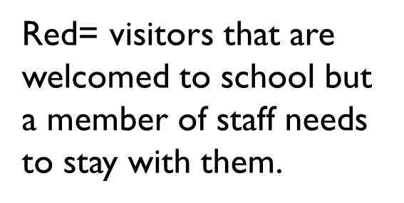
Red

Slide 13
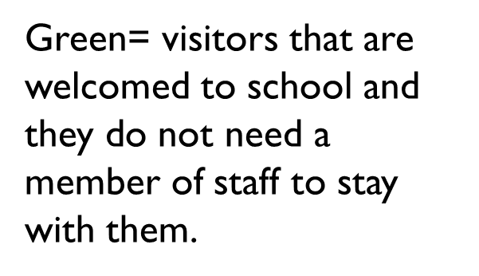
green

